Slide 1
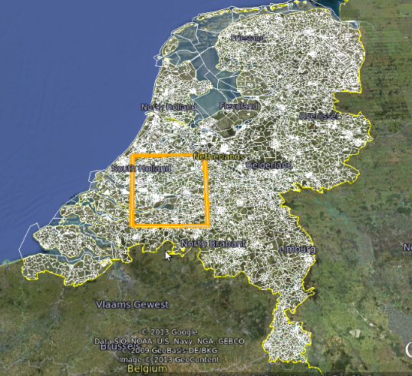
Geo Module
Masoumeh Seydi
DBIS Uni Konstanz
Aug. 2013

Slide 2
Overview
Introduction
Geo Module in BaseX
Spatial Index
Performance
Conclusion

Slide 3



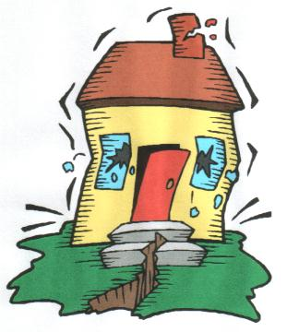
Motivation
Widely used nowadays
Disaster Management

Slide 4
Geo Spatial Data
    Geographic properties
    Coordinates and topologies
GML
WKB
WKT
GML, extensive XML based language:
  W3C XML Schema Language
  Developed by OGC
KML
...

Slide 5


Why GML?
Compete ??!!!
Dynamic spatial data sources
Schema changes
Fancy semantic issues (data & schema)
Integration of all geographic information
No default coordinate system

Slide 6
EXpath Geo Module Specification
Geospatial API function interface
Functions conforming OGC
Namespace conventions
Error management
Xquery or XSLT functions

Slide 7







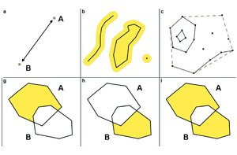

JTS Topology Suite
JTS

Slide 8

Geo Module in BaseX
Geo: Expath functions
JTS
GeoError: Error definitions
→
BaseX-API
GeoTest: Test functions
GmlReader
GeoIndex: Index functions
→
BaseX Core
Index structure

Slide 9
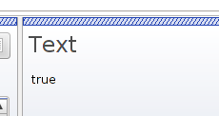
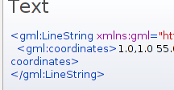

Geo Module Functionality
<gml:Polygon> …. </gml:Polygon>
Read
<gml:Polygon> …. </gml:Polygon>
Geometric operation
....
touches
intersects
boundary
distance
Outputs

Slide 10
Geo Module in Practice
let $x := <gml:Polygon>
  <gml:outerBoundaryIs>… </gml:outerBoundaryIs>
<gml:Polygon>
for $p in //gml:Polygon
return if ( intersects($x, $p) ) then $p else ()
Unnecessary readings,
big time complexity

Slide 11
Geo Module in Practice
let $x := <gml:Polygon>
  <gml:outerBoundaryIs>… </gml:outerBoundaryIs>
<gml:Polygon>
for $p in DB//gml:Polygon
return if ( intersects($x, $p) ) then $p else ()
Unnecessary readings,
big time complexity
Indexing

Slide 12
Spatial Index
R-Tree, Antonin Guttman in 1984
  Common indexing technique
  Some disadvantages
STR-Tree, Leutenegger et al. In 1997
  → Improved performance of R-Tree
JTS STRtree:
  Serializable
  Two step filtering

Slide 13
R-Tree
Intersection queries
R1
R2
R7
R11
R8
R3
R12
R9
R5
R10
R13
R4
R6
R14

Slide 14
R-Tree (Cont'd)
Query area
R2
Filtered rectangles
R12
R5
R14
R6
R12, R14 → chosen objects

Slide 15
Indexing
Once:
a.gml
….
…...
read
serialize
a.file
Pre values
Build a STRtree
Query time:
Read to memory
Geometric operation
a.file
Pre values
Filtering

Slide 16
Indexing: GeoIndex Module
Index functions in a separated module
let $a:= <gml:Polygon>... </gml:Polygon>
return geo-index:intersects("DB", $a)
New function implementations, using index structure
Contains filtering

Slide 17
Implicit Indexing
GeoIndex.java
…
..
filter (...)
…
..
Geo.java
…
..
intersects (...)
…
..
let $a:= <gml:Polygon> … </gml:Polygon>
for $x in geo-index:filter("DB", $a)
return if (geo:intersects($a, $x)) then $x else ()
Filtering func.
Original geo function

Slide 18
Implicit Indexing
GeoIndex.java
…
..
filter (...)
…
..
Geo.java
…
..
intersects (...)
…
..
let $a:= <gml:Polygon> … </gml:Polygon>
for $x in geo-index:filter("DB", $a)
return if (geo:intersects($a, $x)) then $x else ()
Filtering func.
Original geo function
Worse performance → Map (cashing)

Slide 19
Map (Cashing)
Prevents creation of the same geometry in each function call
Used in Geo functions
→ Shorter query time
for $x in geo-index:filter("DB", $polygon)
return if (geo:intersects($polygon, $x)) then $x
else ()
Every time $polygon is created

Slide 20
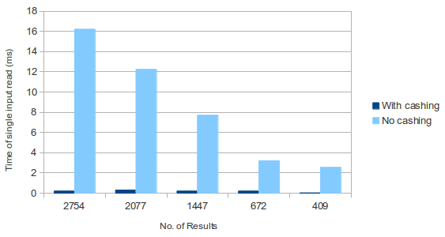
Map (Cont'd)

Slide 21
Query Examples
Data
  Netherlands Map in GML 2.0
  From University of Twente, Dept of Geoinformation Processing
Visualization
  Automatic conversion from GML to KML
  Google Earth

Slide 22
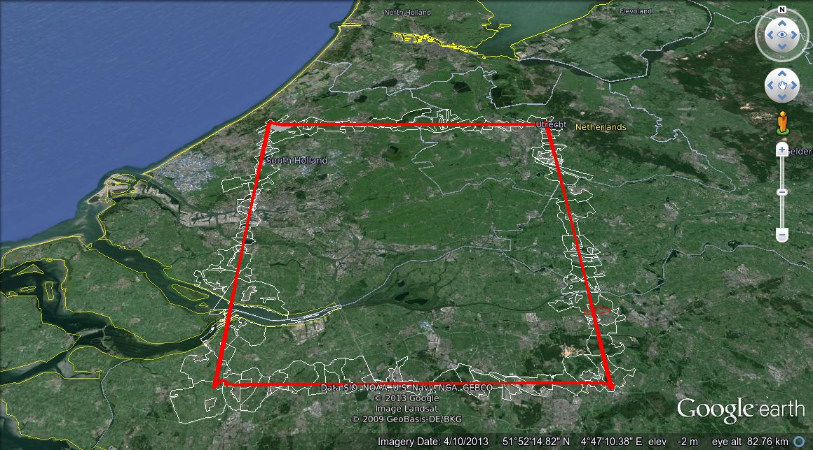
Query Examples (Cont'd)
A set of geometries and a query geometry
overlaps

Slide 23
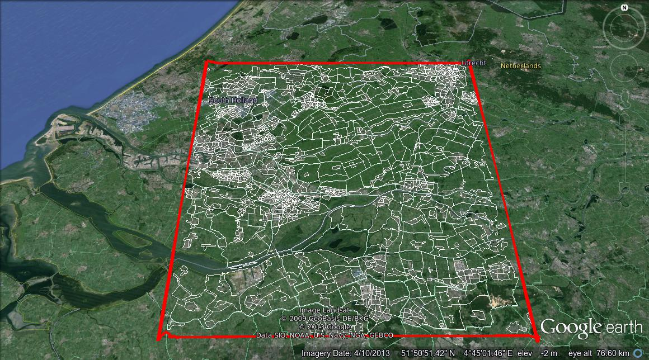
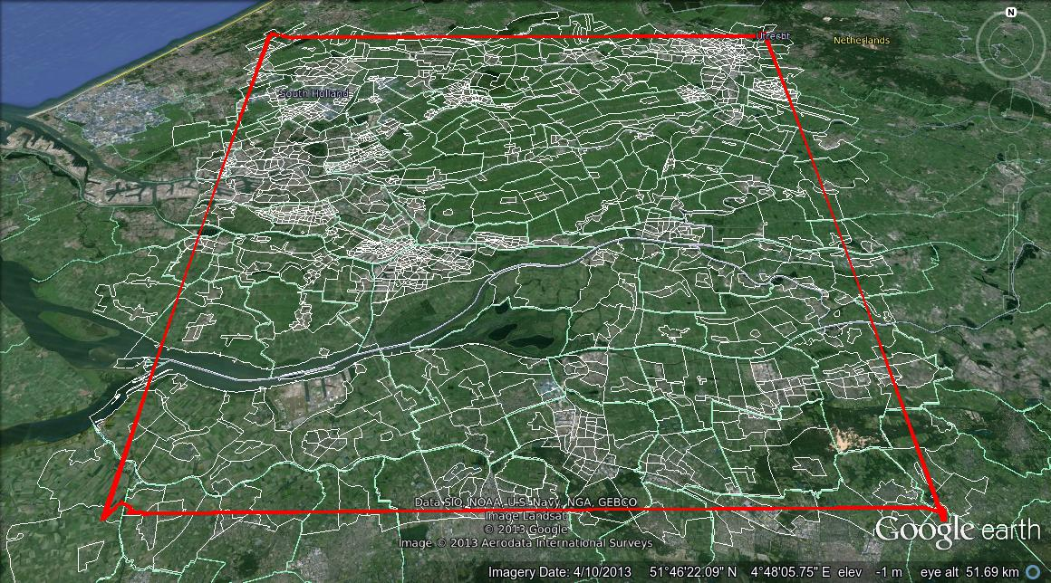
Query Examples (cont'd)
contains
intersects

Slide 24
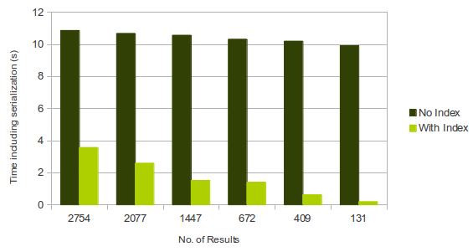
Index Efficiency
2800
2093
1451
682
415
138
Better performance, not satisfying ...

Slide 25
GML Reader
Serializing the XML node
  String
JTS
Geometry

Slide 26
GML Reader
Serializing the XML node
Parse
  String
JTS
Geometry
BaseX node Geometry

Slide 27
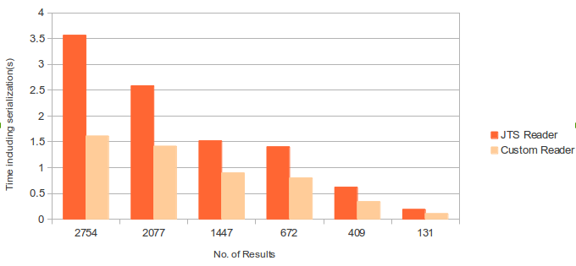
GML Reader: JTS vs Custom

Slide 28
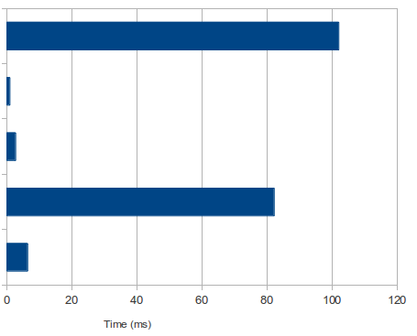
Detailed Timing
let $a:= <gml:Polygon> … </gml:Polygon>
return (
geo-index:filter("DB", $a)
[geo:intersects( . , $a)]
)
1451 Objects filtered
Total time
(1447 results)
Filtering
intersects
Reading all geometries
Reading input geometry

Slide 29
Detailed Timing (Cont'd)
rank self accum count method
1 6.95% 6.95% 94 org.basex.util.Token.split
2 5.33% 12.28% 72 org.expath.ns.GmlReader.createPolygon
3 4.59% 16.86% 62 org.basex.util.Token.split
4 4.22% 21.08% 57 org.basex.query.func.
            JavaModuleFunc.eval
5 3.55% 24.63% 48 org.expath.ns.Geo.geo
6 3.18% 27.81% 43 org.basex.util.Token.split
7 3.03% 30.84% 41 org.basex.util.Token.split
8 2.96% 33.80% 40 org.basex.util.Token.split
9 2.74% 36.54% 37 org.expath.ns.Geo.geo
….

Slide 30
Conclusion
Geo spatial functions in BaseX
Ability to do Geo-Query
Indexed geometric operations
Real-world test cases

Slide 31
Future Works
Profiling
Performance tuning
Geo spatial visualization
Supporting other common encoding (GML 3, OSM, KML, …)
Conversion between encodings
Path finding (traffic segments) in a map

Slide 32
References
http://expath.org/spec/geo
Leutenegger S., Edgington J.M., Lopez M.A., STR: A Simple and Efficient Algorithm for R-Tree Packing, NASA Contractor Report 201661, ICASE Report No. 97-14, February 1997
"Secrets of the JTS Topology Suite - M. Davis". May 2013
S. Steiniger and A.J.S. Hunter "The 2012 Free and Open Source GIS Software Map – A Guide to facilitate Research, Development and Adoption"
http://lin-ear-th-inking.blogspot.de/2007/06/history-of-jts-and-geos.html
http://en.wikipedia.org/wiki/R-tree
Y. Manolopoulos; A. Nanopoulos; Y. Theodoridis (2006). R-Trees: Theory and Applications. Springer. ISBN 978-1-85233-977-7. October 2011
http://www.digitalpreservation.gov/formats/fdd/fdd000296.shtml
http://blog.dc.esri.com/2006/11/20/geodata-format-wars-gml-vs-kml-vs/

Slide 33
Suggestions for the related Master thesis topics are welcomed!
Thank you!

